Slide 1
SQL for Data Querying and Analysis
Week 4 Lecture

Slide 2
Agenda
Review
Analytic Functions Intro
Rank Functions
Multiple Rankings – Windows
Window Frames
LAG and LEAD Functions

Slide 3
Review!
Sub queries are a query within another query
The result of a sub query can be a single row and single column, multiple rows and single column or multiple rows and multiple column
Sub queries are executed before the rest of the query
The CASE expression is SQL’s optimal method to express and execute conditional logic
CASE expressions and sub queries are often used together!

Slide 4
Analytic Functions

Slide 5
Analytic Functions Intro
Analytics functions provide ways to perform analyses within SQL server
You’ve done all the work bringing the data together, why not do some analysis!
Why leverage analytic functions?
Save processing time
Eliminate need to transfer your result set into another specialized analysis tool

Slide 6
Rank Functions
Rank functions generate a column that represents the rank of each row based on the values you set in your query
Rank Functions
Row_number: Generates unique number for each row. Ties handled arbitrarily.
Rank: Returns same ranking in case of tie with gap in the rankings
Dense_rank: Returns same ranking in case of a tie with no gap in the rankings
Percent_rank: Returns percentile rank of a row, meaning what percent of values less than the value in the current row

Slide 7
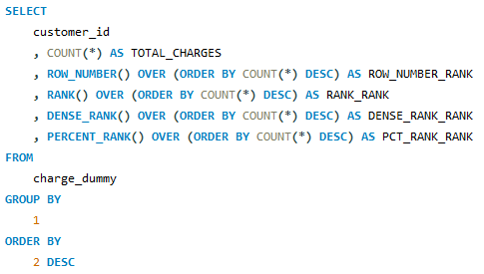
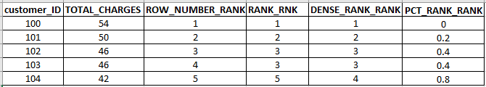
Rank Function Example

Slide 8
Demo Set 4.1

Slide 9
Multiple Rankings
Analytics functions become much more powerful when you leverage windows with the partition by clause
This enables multiple grouped rankings within one column
The partition by clause partitions the data into windows and generates the ranking within each window
Rank is reset at beginning of each new window

Slide 10
Demo Set 4.2

Slide 11
Reporting Analytic Functions
In addition to rankings analytic functions can leverage all other available aggregate functions
SUM, AVG, MIN, MAX, COUNT
How you use the over clause dictates how the aggregation is calculated

Slide 12
Demo Set 4.3

Slide 13
Window Frames
Window frames come in handy when you need more control over which rows to include in a data window
Instead of defining windows based on their column values you define windows based on their row position
Common uses of window frames include running totals and rolling averages

Slide 14
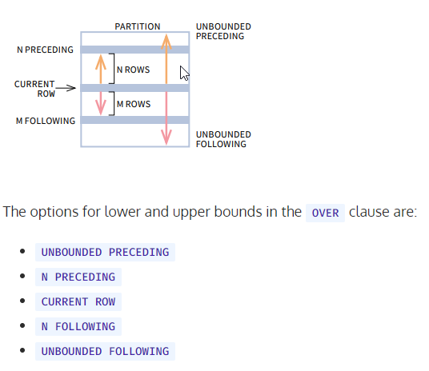
Windowing Clause Syntax
Credit: https://learnsql.com/blog/define-window-frame-sql-window-functions/

Slide 15
Demo Set 4.4

Slide 16
Lag and Lead
Along with summing and averaging over a data window, another common task is comparing values from one row to another
LAG function retrieves value from previous row
LEAD function retrieves value from following row
Use Case: show percentage difference from previous row

Slide 17
Demo Set 4.5

Slide 18
Unbounded Preceding vs Empty Windowing Clause
While conceptually, empty windowing clauses and setting your window clause to ‘ROWS UNBOUNDED PRECEDING’ may seem the same, there are key differences in how they treat ties in the ORDER BY clause
Analytic functions with an empty window clause treat ties in the ORDER BY clause as one conflated row and return same value for each row
Analytic function with ROWS UNBOUNDED PRECEDING in the window clause treat ties in the ORDER BY clause as separate rows

Slide 19
Demo Set 4.6

Slide 20
Analytic Function Syntax Overview
Specify which analytic function you are calling
Column on which aggregation is performed
Defines the group of rows on which the aggregation is performed
Analytic_Function([ arguments ]) OVER ([partition_clause ]
[ order_by_clause [ windowing_clause ] ])
Orders the rows within a partition for execution
Similar to partition clause, gives further control over what window of rows function is applied

Slide 21
Resources to Practice
WindowFunction.com: https://www.windowfunctions.com/questions/over/1
Code Academy SQL Course: https://www.codecademy.com/learn/learn-sql
SQL Zoo: https://sqlzoo.net/
W3 Schools: https://www.w3schools.com/sql/sql_exercises.asp

Slide 22
Thank You!

Slide 23
Appendix

Slide 24
XXX
List functions here

